Slide 1
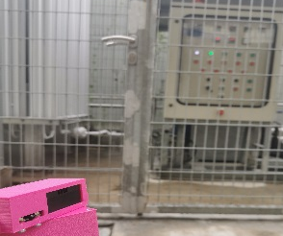
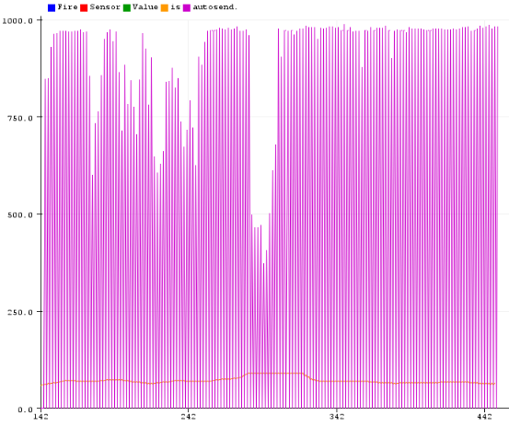
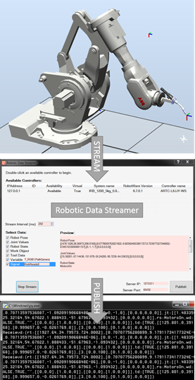
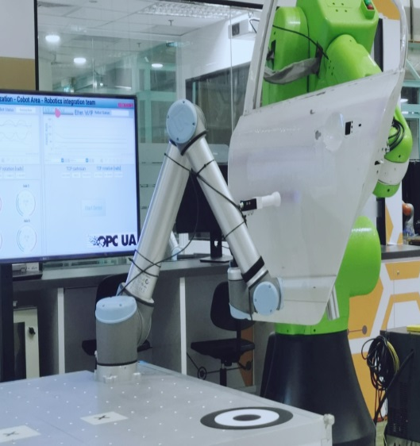
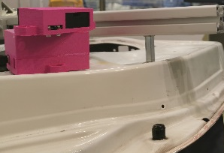
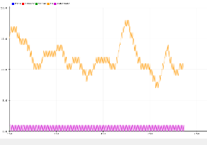
Project Completed
Proj. Code | Proj. Title | Description | Team Members
ARTC19_02_ARA | ARA Digitalization - HS&E and Process Quality Enhancement through IIoT | Project completed. Customer feedback: Project was demonstrated during the BTM 2019, attracting the attention of several customers. The project has enabled a simplified way for extracting robot information. Technical accomplishment: Different robot brands and devices are able to communicate under the same platform. Combined multiple industrial protocols (EtherCAT, EtherNET/IP, ModBUS TCP and standard buses) to provide process data. Developed ABB plug-in that allows the monitoring of ABB robots The development of the previous plug-in has allowed projects like “KBM” to reach success. Developed a “wrapper” to obtain data from BOSCH CISS sensors. This connectivity development, allows data to be read from ROS nodes as well as PLCs. The outcome of this project will serve to connect devices and identify basic dangerous scenarios in robotic environments. | Pintor Ortiz Walter Frank Vijay Yadunund
Honeywell sensor - Detecting contamination
Honeywell sensor – Safe environment
Data robot streamer – Supported the success for KBM
Robots working under same platform – Data standardized and shared using OPC-UA
BOSCH CISS – ROS – The integration of these sensors will improve navigation and localization algorithms as well

